Slide 1
PHYS60022 Data Science and Machine Learning for Physics
Week 6: Performance Metrics
Patrick Dunne, p.dunne12@imperial.ac.uk

Slide 2
Learning Outcomes
Learning outcomes for today
Introduce the concept of decision trees for classification and regression
Know how to use decision trees in SKLearn
Learn the disadvantages of basic decision trees
Introduce ensemble methods
Introduce boosting as a specific ensemble method

Slide 3
Decision trees

Slide 4
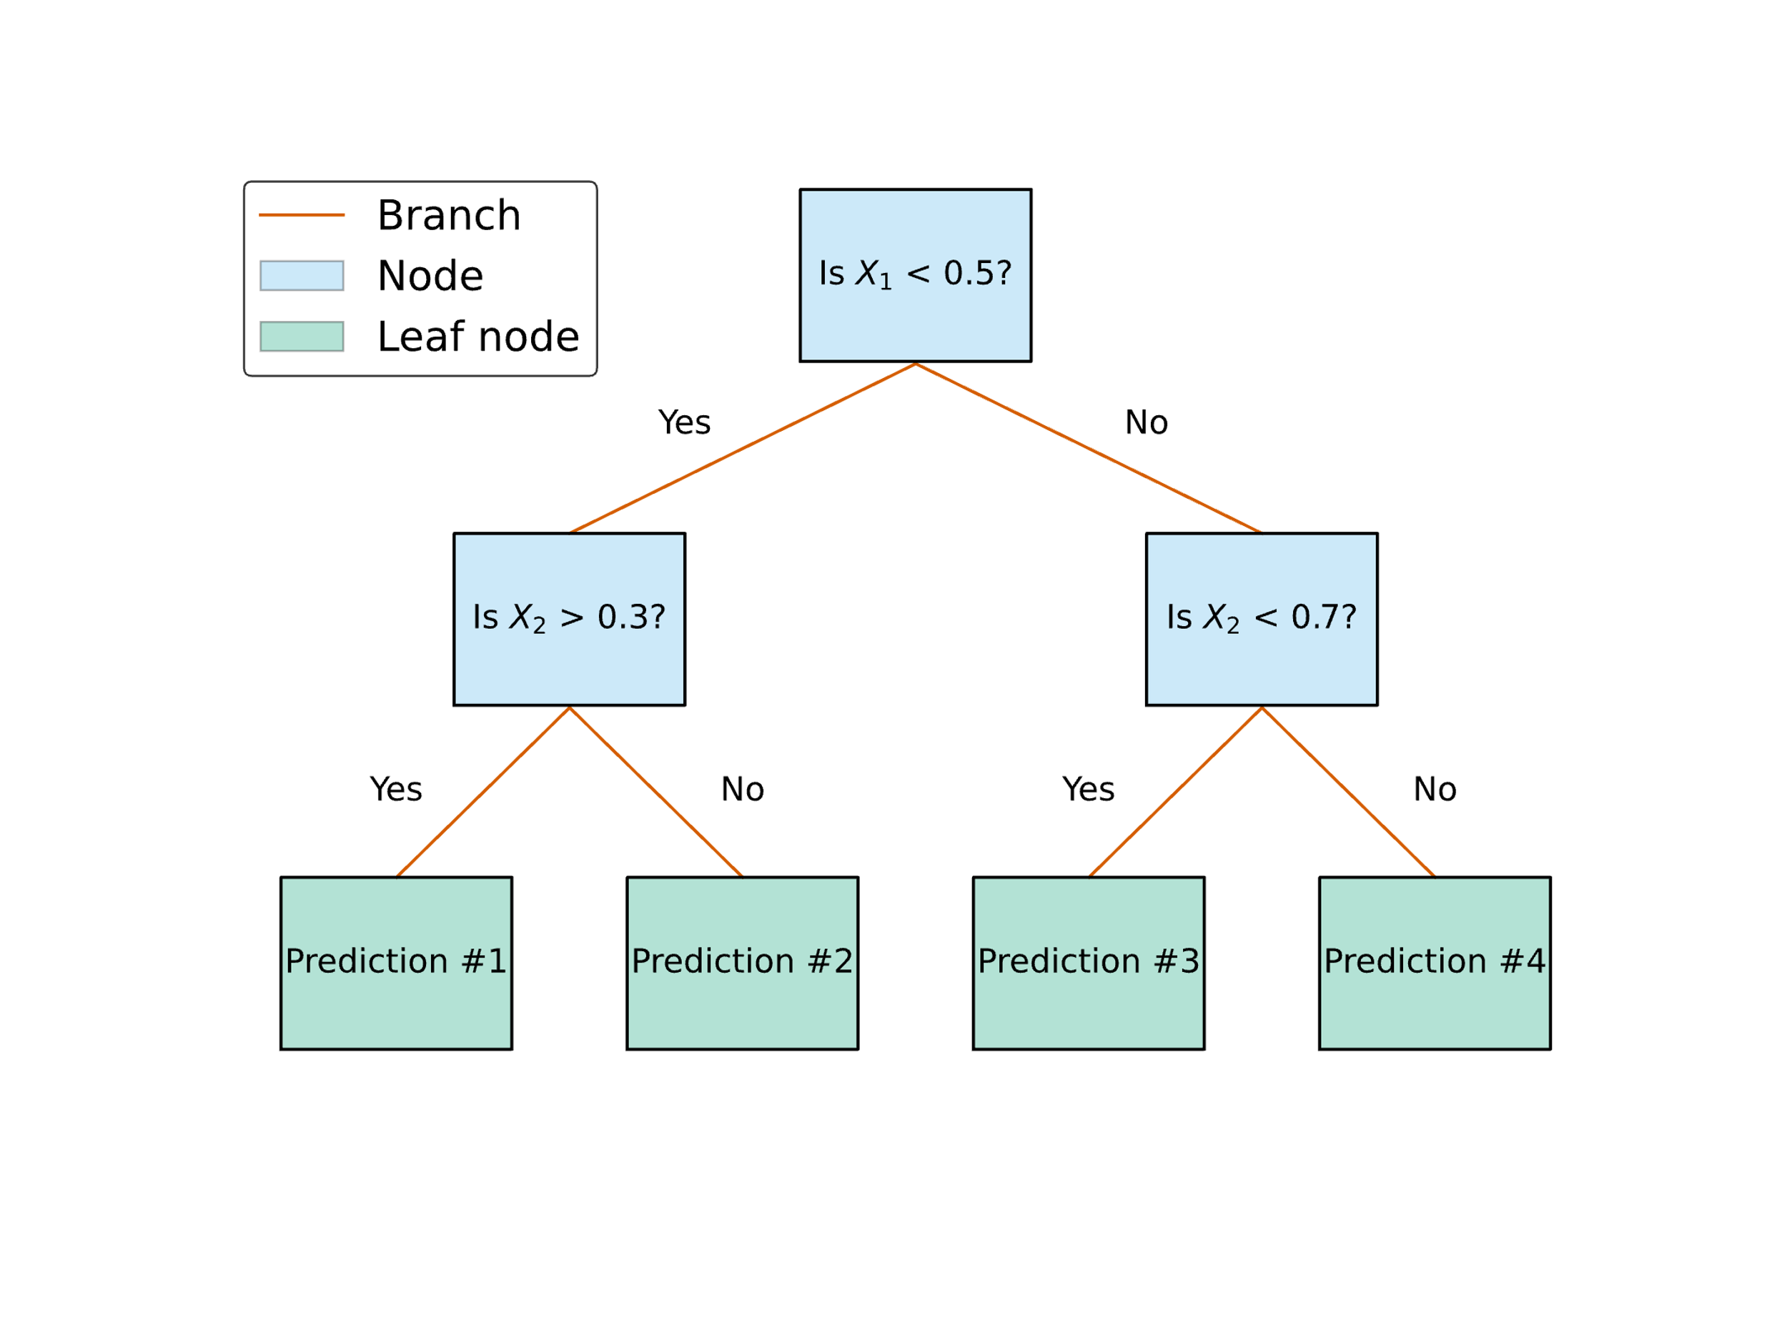
What is a decision tree?
Mathematically a directed acyclic graph
Colloquially a tree for making decisions
Start at the top node of the graph (‘root node’)
At each node decide which edge of the graph (‘branch’) to go down using the decision criterion of the node
Continue until you reach a final node which gives you the class/value for your data point
Called ‘leaf nodes’

Slide 5
What is a decision tree?
Mathematically a directed acyclic graph
Colloquially a tree for making decisions
Start at the top node of the graph (‘root node’)
At each node decide which edge of the graph (‘branch’) to go down using the decision criterion of the node
Continue until you reach a final node which gives you the class/value for your data point
Called ‘leaf nodes’

Slide 6
What is a decision tree?
Mathematically a directed acyclic graph
Colloquially a tree for making decisions
Start at the top node of the graph (‘root node’)
At each node decide which edge of the graph (‘branch’) to go down using the decision criterion of the node
Continue until you reach a final node which gives you the class/value for your data point
Called ‘leaf nodes’

Slide 7
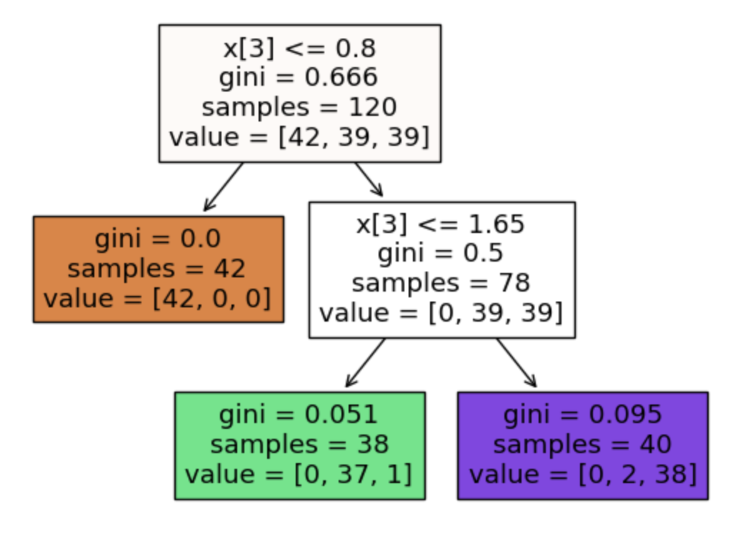
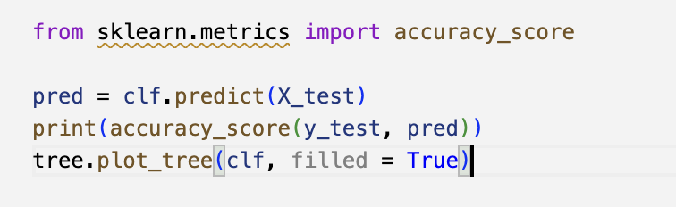
Easy to define one in sklearn
Easy to print a plot of the tree as well

Slide 8
How do we train a decision tree?
This is machine learning we’re not choosing the cut values by hand!
This is our first example of a model-based method
Aim is to define a metric for how good any ‘split’ is
Ie how well it splits our data into our classes
Common choice is Gini impurity
Might have heard of this as a metric of inequality in social science
Generally this question is called determining our ‘loss function’

Slide 9
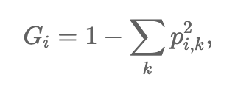
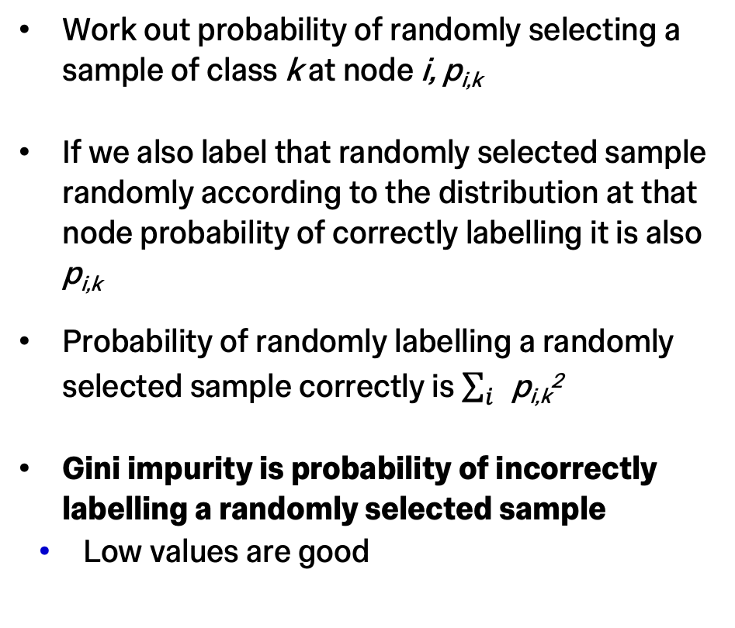
Gini Impurity
Work out probability of randomly selecting a sample of class k at node i, p_{i,k}
If we also label that randomly selected sample randomly according to the distribution at that node probability of correctly labelling it is also p_{i,k}
Probability of randomly labelling a randomly selected sample correctly is $\sum_{i}{\text{p}\text{i}\text{,}\text{k}\text{2}}$
Gini impurity is probability of incorrectly labelling a randomly selected sample
Low values are good

Slide 10
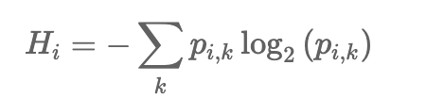
Alternatives and training
Log-loss or entropy does a similar job
Entropy is zero if node contains only one class
Ie if node is perfectly classified

Slide 11
Alternatives and training
Just defining loss doesn’t say how you train
Typically optimise loss function
By node?
Overall? How do you do that?
Do it once or several passes through?
Many algorithms to train decision trees
Details in notebook

Slide 12
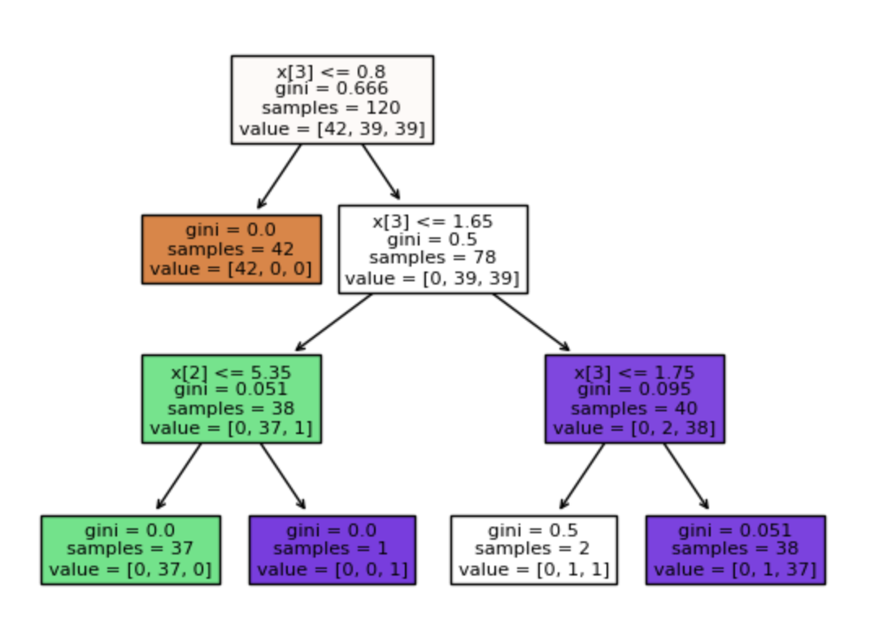
Alternatives and training
Just defining loss doesn’t say how you train
Typically optimise loss function
By node?
Overall? How do you do that?
Do it once or several passes through?
When do you stop?
Many algorithms to train decision trees
Details in notebook
Common hyperparameters:
Maximum depth
Minimum samples per leaf
Minimum samples per internal node

Slide 13
Why not a simple tree?

Slide 14
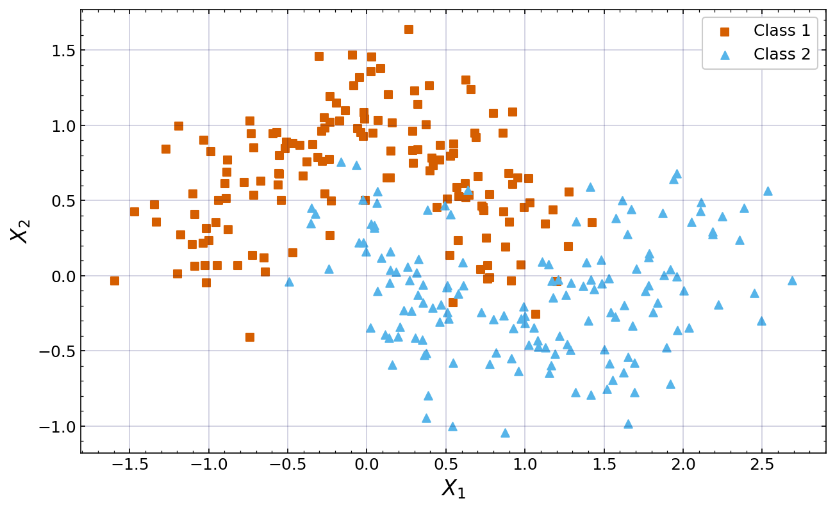
Example
Train decision tree with maximum depth 200 on this data

Slide 15
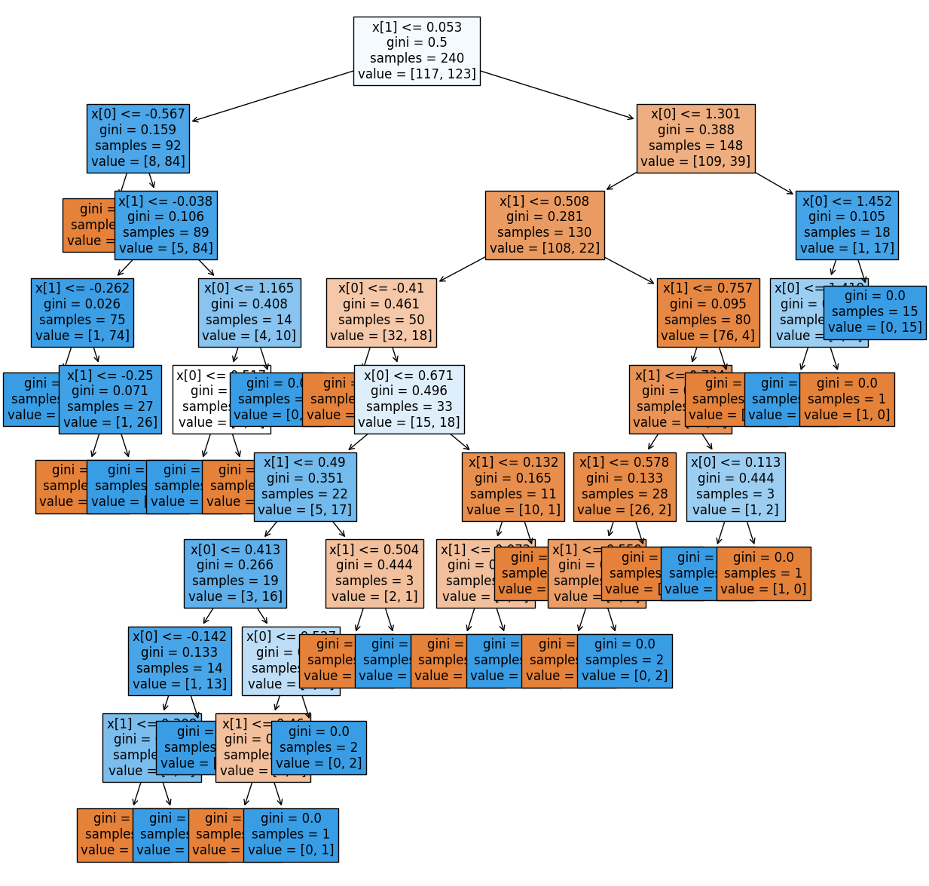
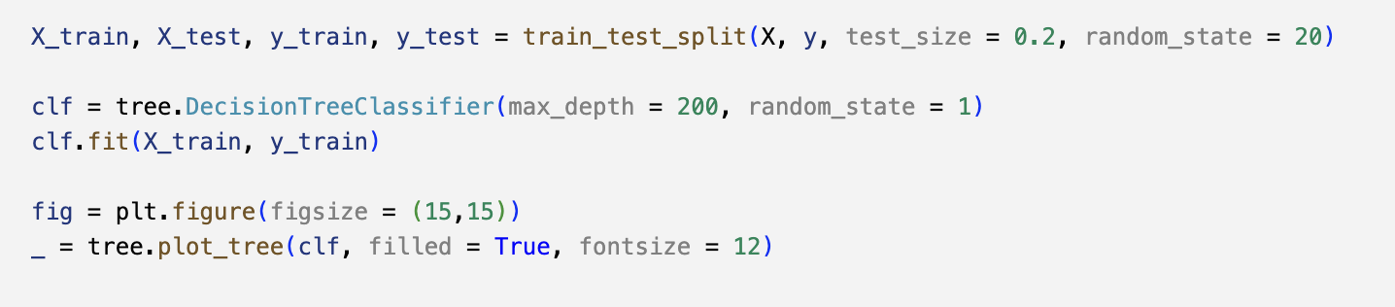
Decision tree on simple data
Easy to do technically:
Very complicated tree for a relatively straightforward problem
Does it do a good job?

Slide 16
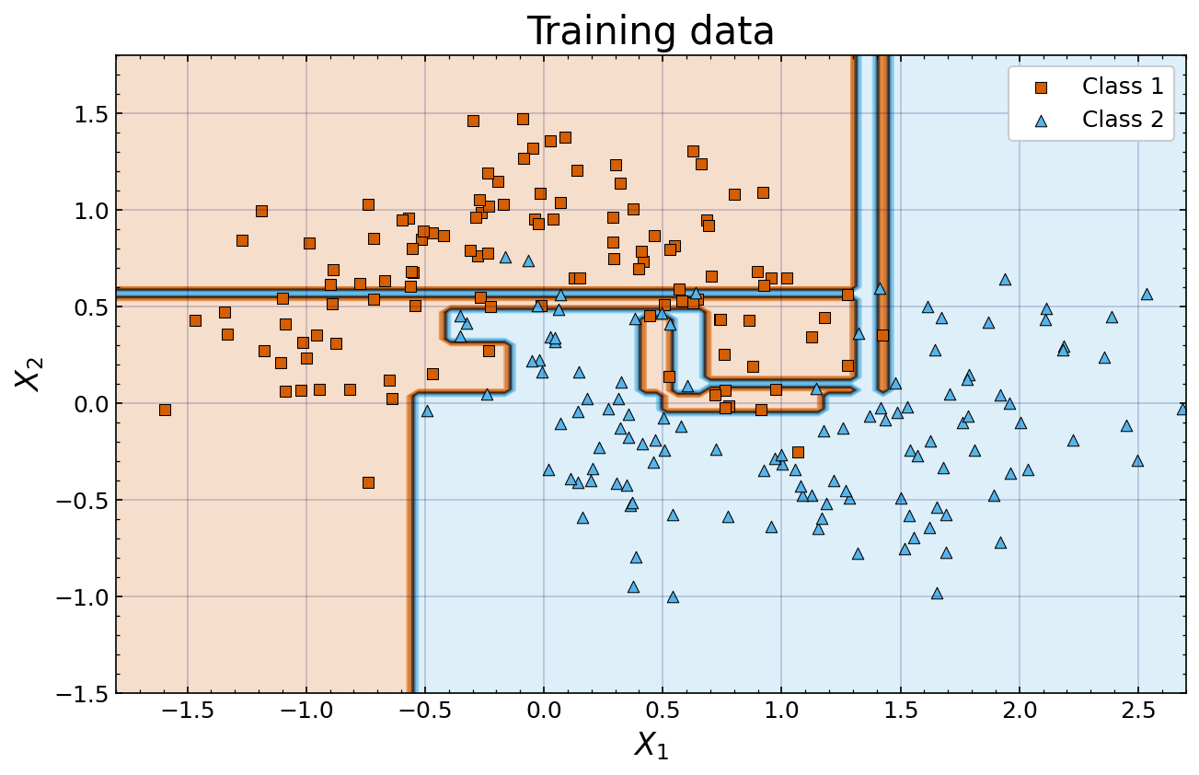
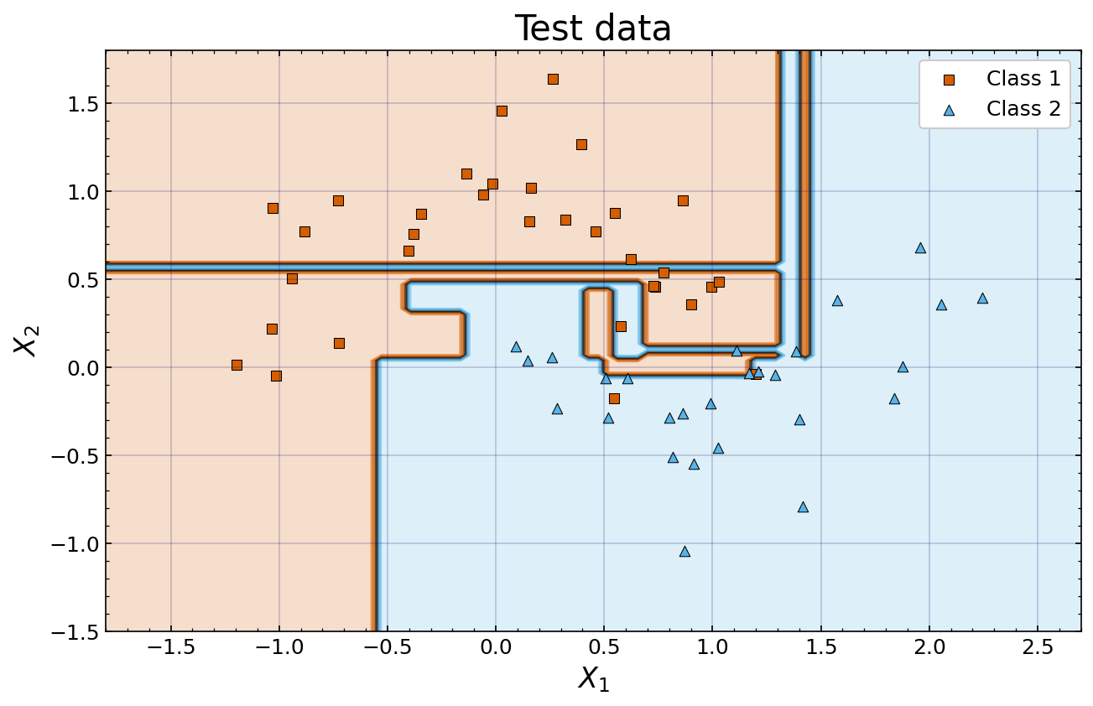
Simple decision tree output
Complex tree leads to complex decision boundary
Clear overfitting to training data
This is a general problem

Slide 17
Ensemble Learning
If one model has problems overfitting why not try several?

Slide 18
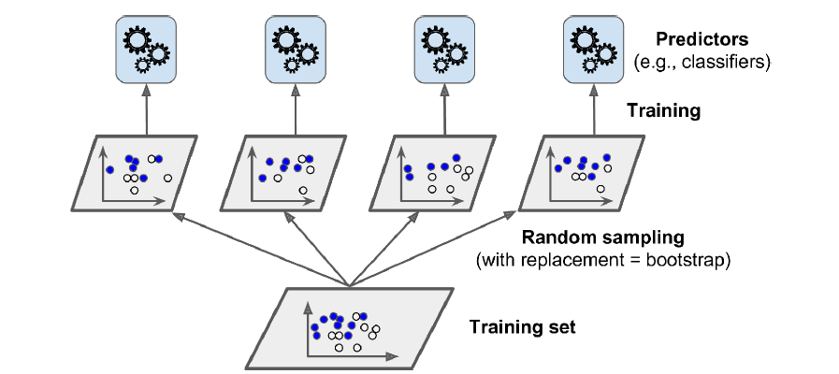
Ensemble learning
General method that can be applied to any model
Use many individual models and implement voting scheme to determine overall prediction of the ensemble
Models don’t have to all be the same type, could combine kNN, SVM, decision tree but usually don’t
Voting for classification
Hard voting: mode of predictions
Soft voting: most probable predicition
Voting for regression
Usually mean or weighted mean
Source

Slide 19
Why do many decision trees give different results?
Each model in ensemble has different task
Normal method is to present them all with slightly different subset of training data
Two key methods to generate sample of N training data entries:
Bagging: Sample from training set WITH replacement. Can have duplicated entries
Pasting: Sample from training set WITHOUT replacement. No duplicated entries
Can test each individual classifier on the data not in its own training sample
Out of bag (OOB) score
Source

Slide 20
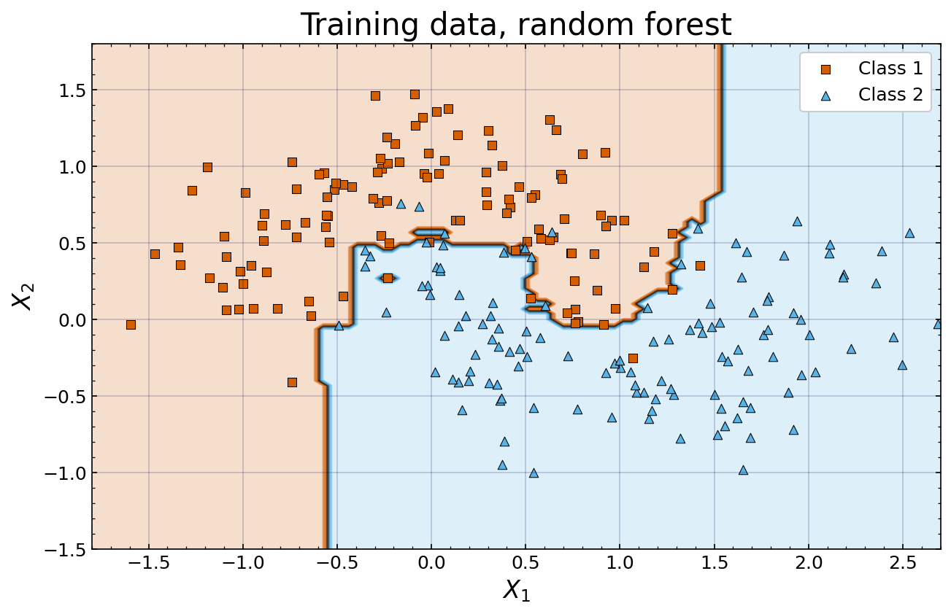
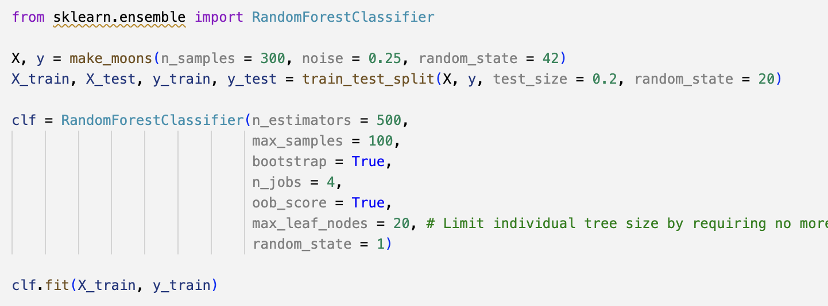
Random Forest
Ensembles with many trees are called random forests
Does a much better job than single tree!
New hyperparameters:
Number of models in ensemble
Number of training samples each model sees
Create samples with bagging or pasting

Slide 21
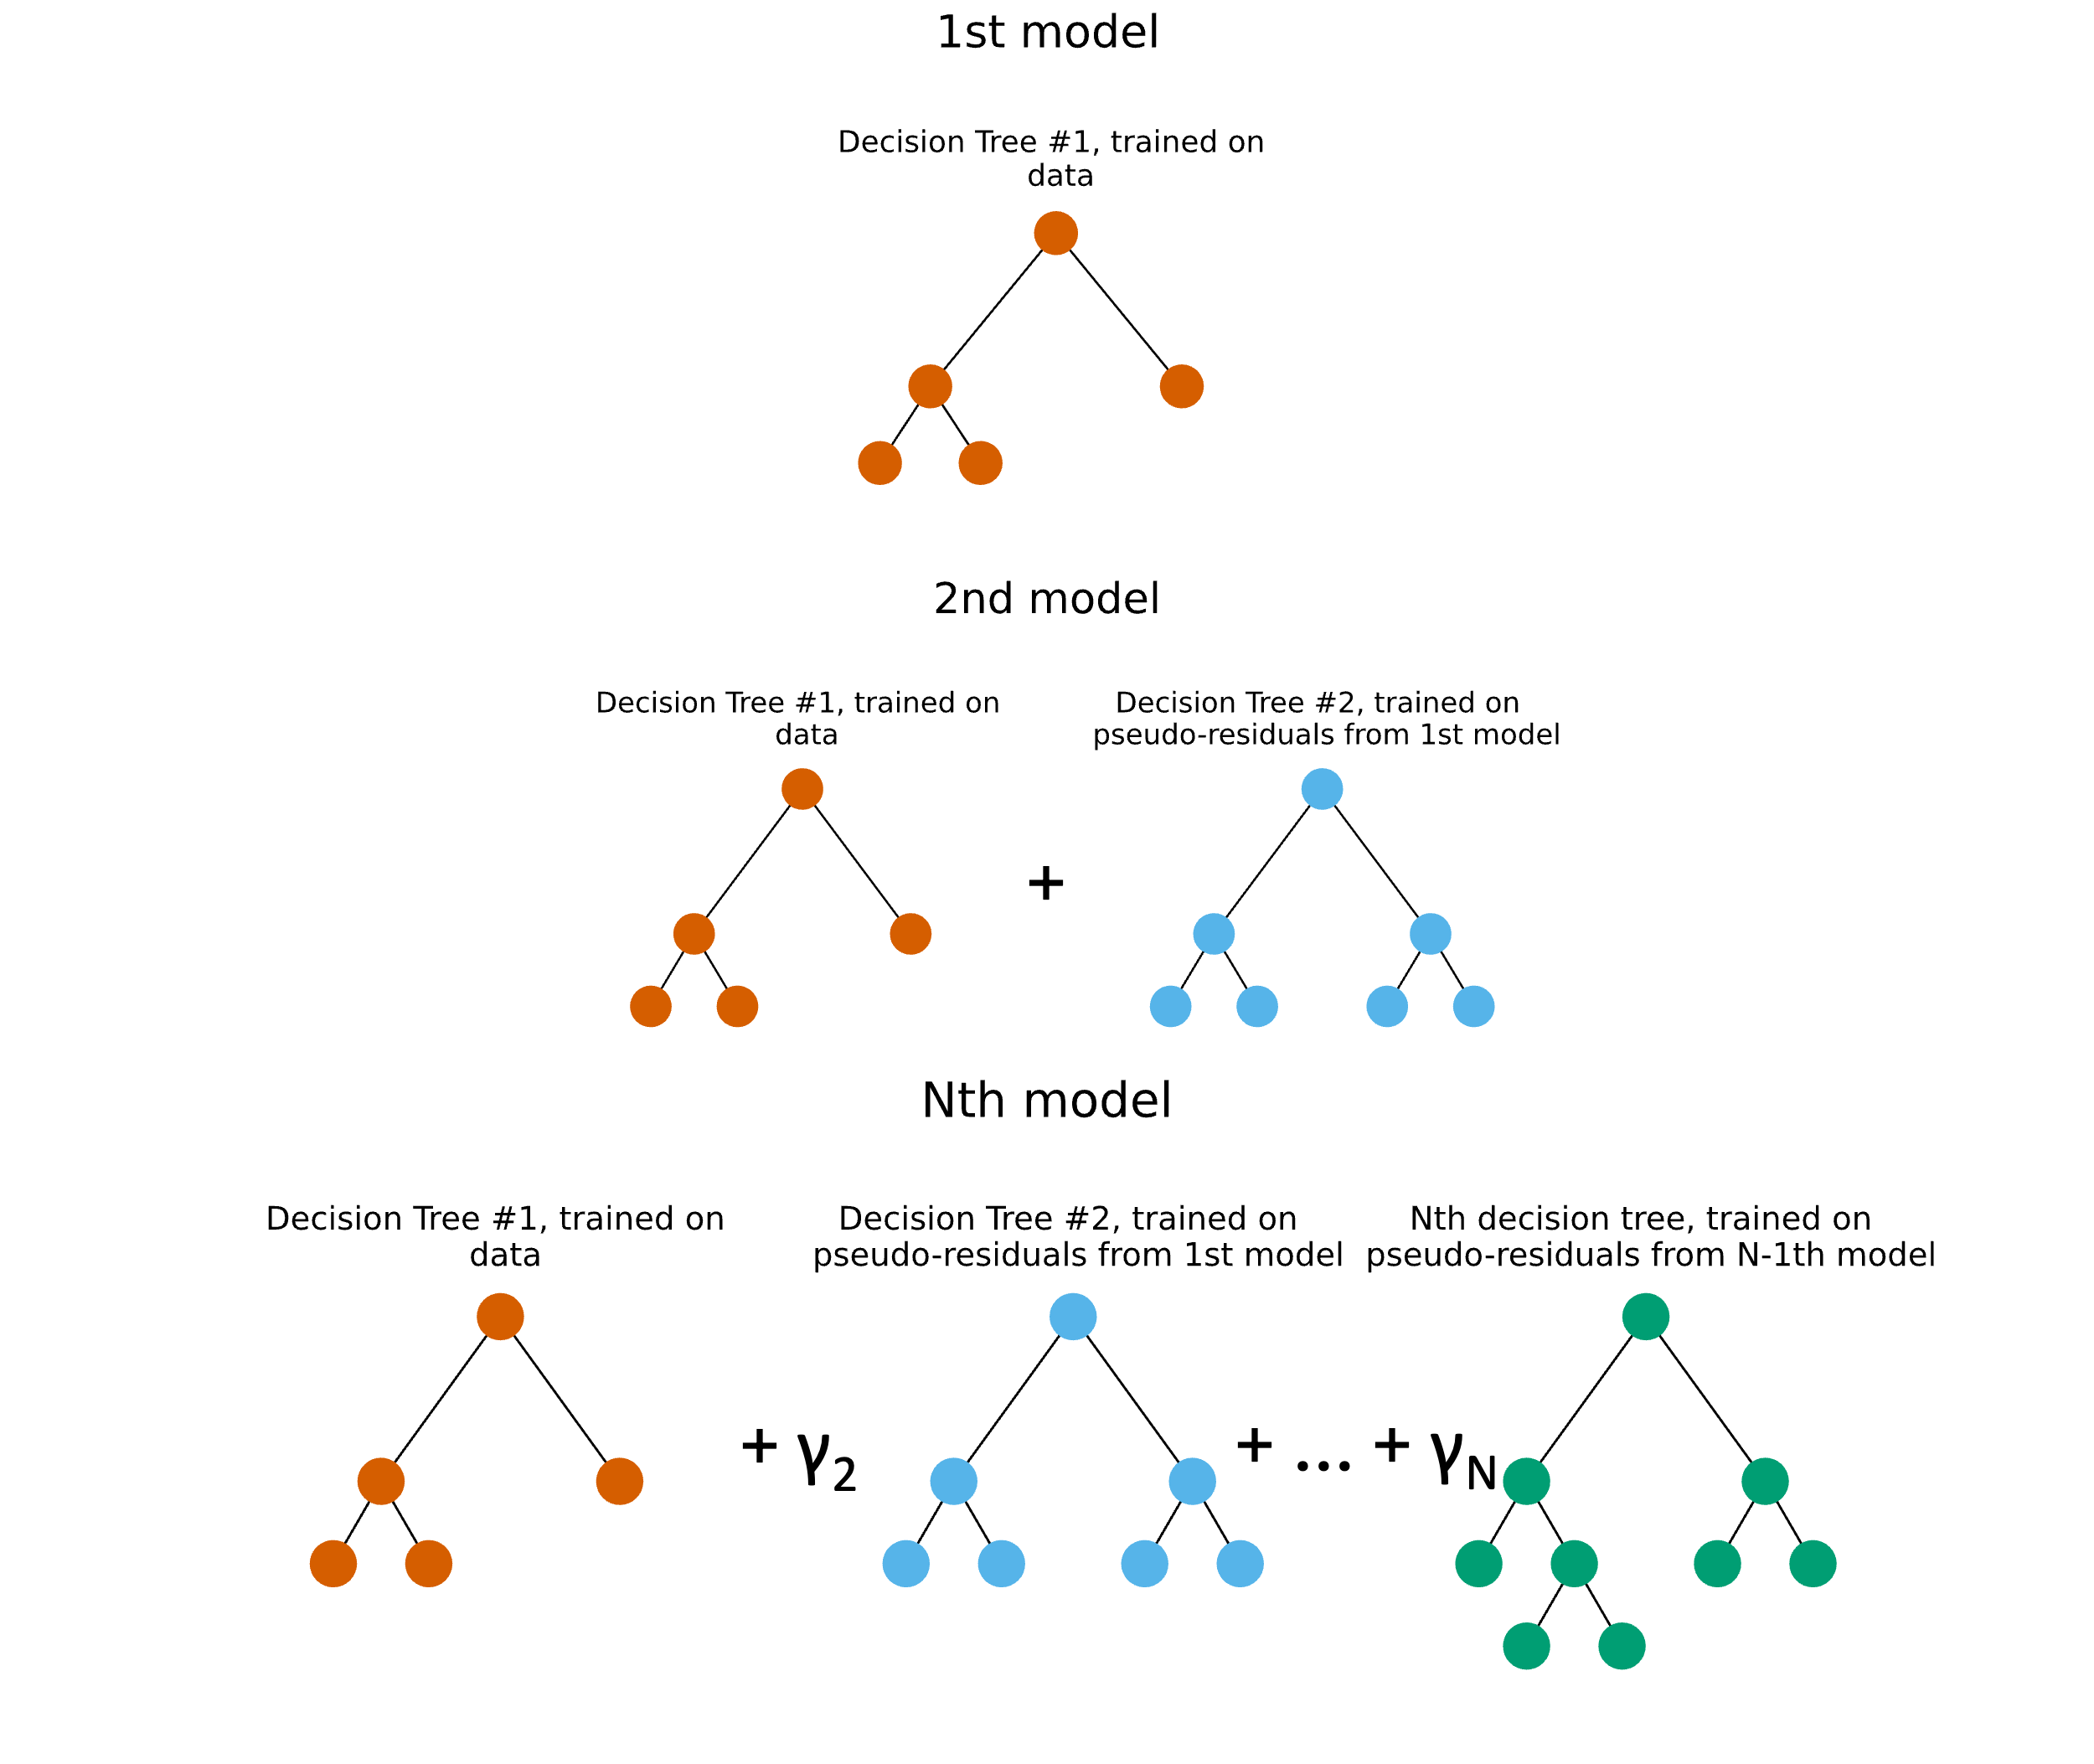
Boosting
Changing training data isn’t the only way to ensemble learn
Boosting uses multiple ‘weak learners’ to result in a ‘strong learner’
Main difference to standard ‘ensemble’ is you iteratively add models to your ensemble to improve it after seeing performance
Will cover two illustrative examples then point you to a state of the art tool
Maths of examples is non-examinable

Slide 22
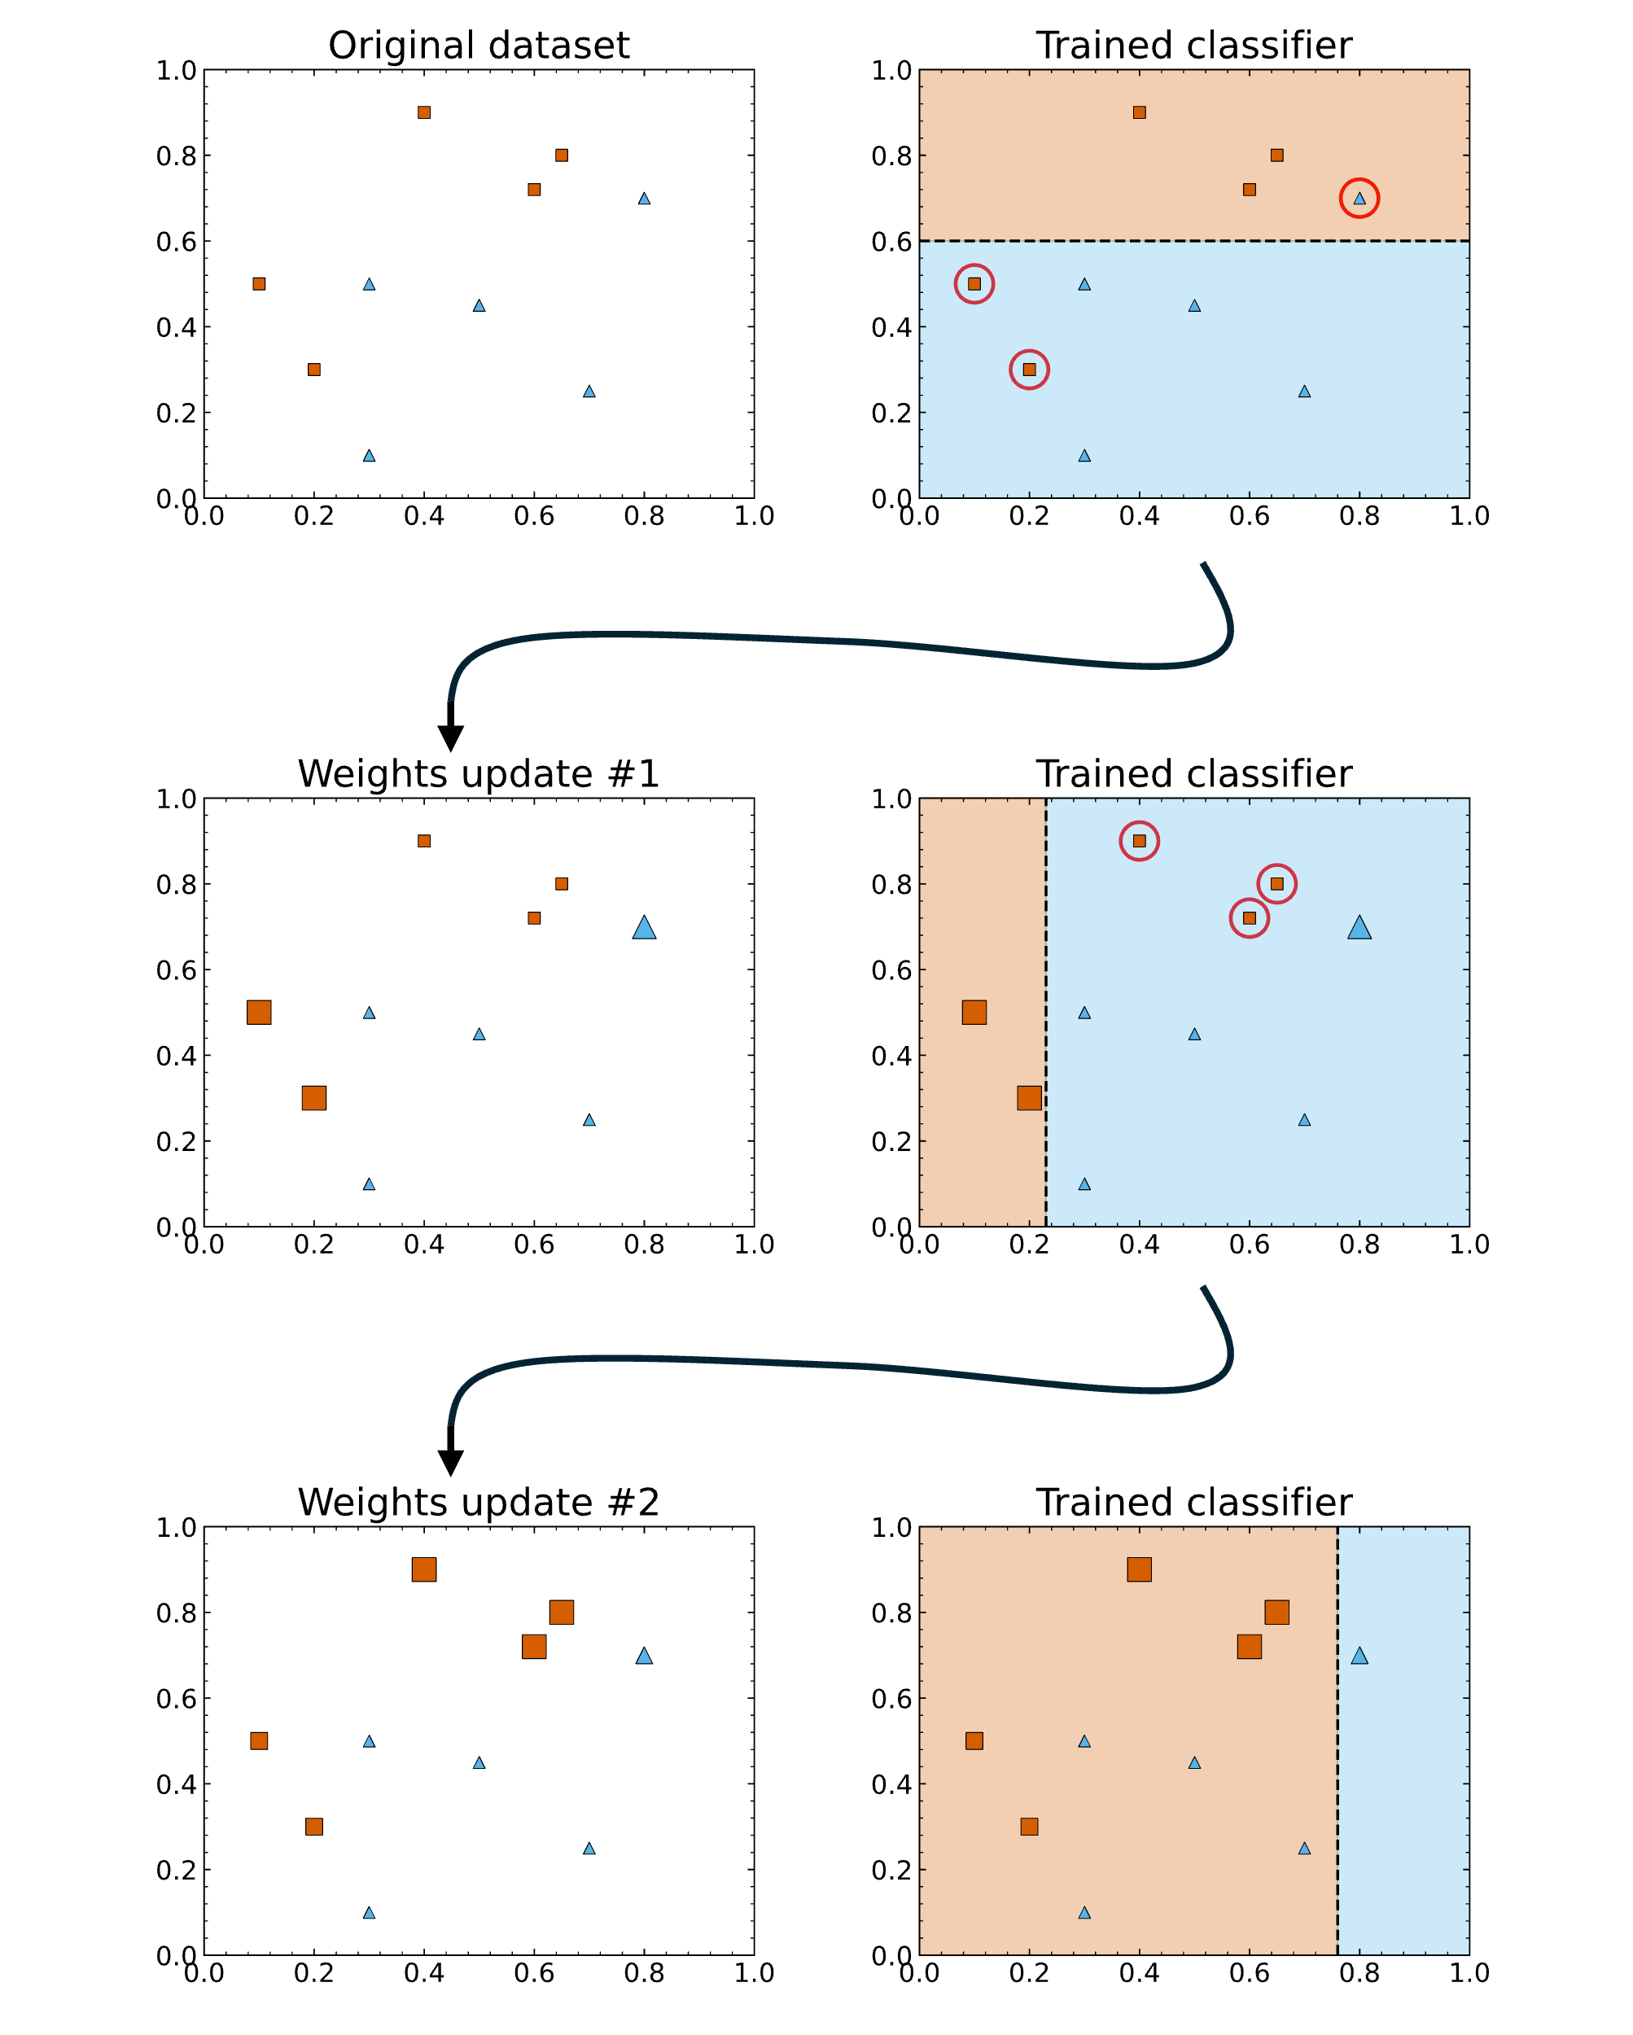
Adaptive boosting (Adaboost)
Each ‘learner’ is a two leaf decision tree
Ie only applies one cut
Start with best single learner you can find
Weight up samples mis-classified by single learner, find new ‘best learner’ and add to ensemble
Repeat until some criterion is met

Slide 23
Gradient boosting
Start with a model that gives all samples a constant output value
Define a differentiable ‘loss function’
Eg our log loss or gini impurity from earlier
Calculate gradient of loss function wrt the output value (called pseudoresidual)
Train a new learner to predict the pseudoresiduals and subtract it from the original model
This is like our ‘gradient descent’ hence name
Repeat until some criterion is met

Slide 24
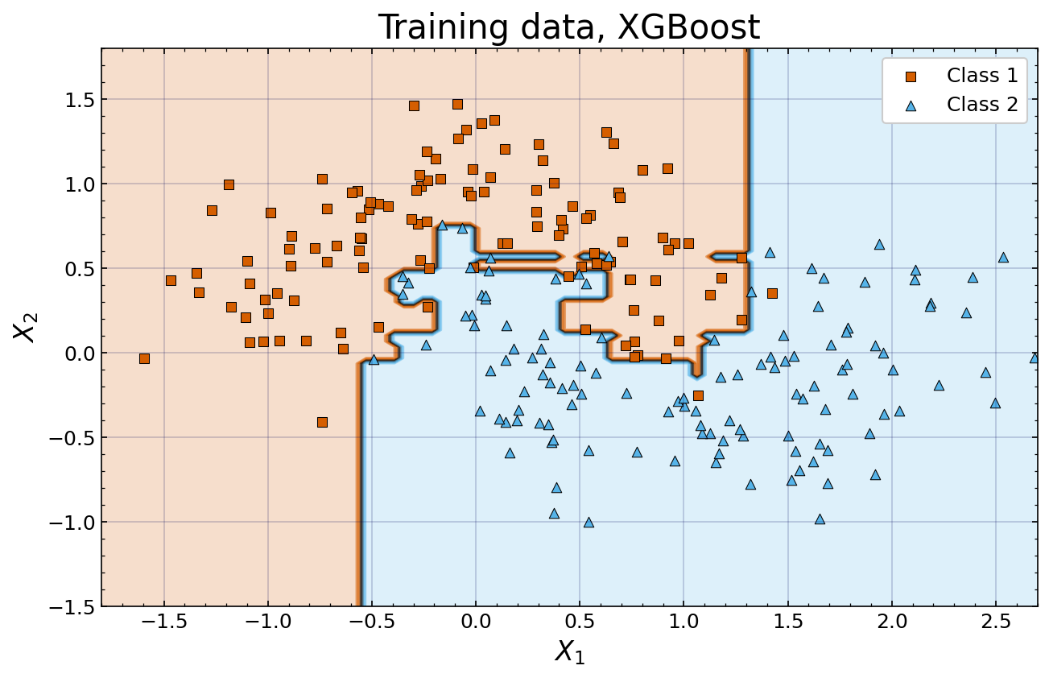
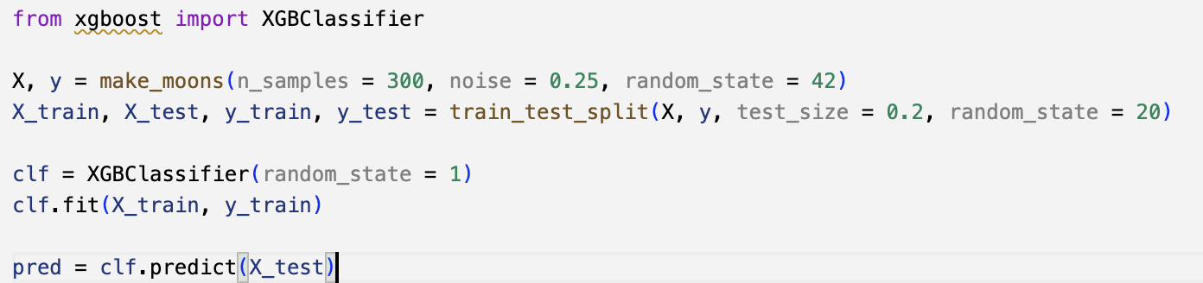
XGBoost
XGBoost is a complex combination of many of the techniques we’ve talked about today
And several more
At its core it is just an ensemble learning tree method though and shares many of its hyperparameters
Using XGBoost is examinable
Available in its own python module works the same way as sklearn

Slide 25
Exercises
Use simple decision trees, random forests and boosted decision trees in a variety of cases:
Classification on simple toy data
Regression on our polynomial example
Classification with MNIST
For all of these perform hyperparameter tuning and produce appropriate performance metrics

Slide 26
Midterm
No lecture next week, 3 hour mid-term test instead
All examinable material up to the end of this lecture is in scope
Test is open book, you may use anything on the internet as long as you don’t talk to or communicate with other people.
AI assistance is allowed subject to college policy of acknowledging in your script what you used and for what
Not graded but if you come in-person and submit by end of exam you will get a 10-15 minute discussion for formative feedback with a marker who has read your submission
Strongly encourage you to take advantage of this as it will be your only opportunity to practise
Additional examination arrangements are being taken into account and organised centrally by the department. Contact Nick and me if you have questions

Slide 27
Exercises!

Slide 28
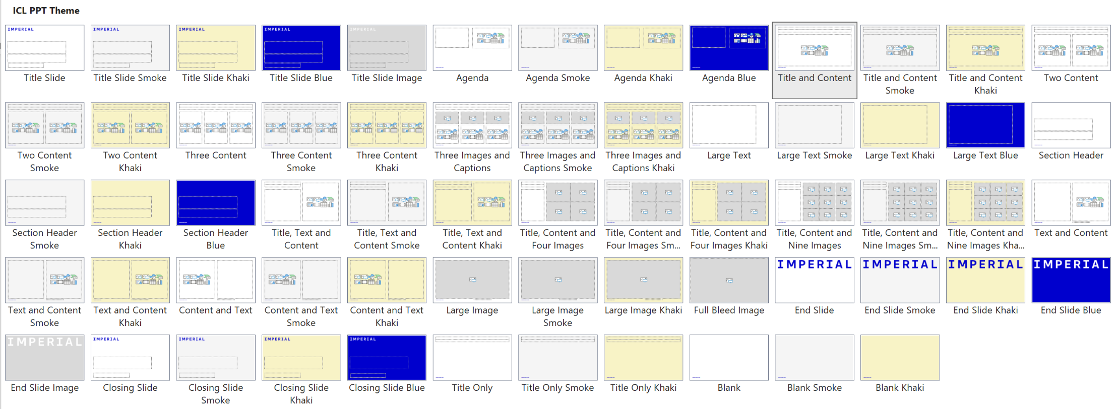
Notes to the template
Custom layouts and example slides
The template includes a range of predefined layouts that you can insert. These have been designed to cater for text, text and images and for picture arrangements. There are also layouts for Title and Divider slides.
Each custom layout includes the correct colour palette, type levels and formatting.
You can choose one of the layouts using the ‘New Slide’ button on the Home tab. You can also change the layout for a current slide using the ‘Layout’ list on the Home tab.

Slide 29
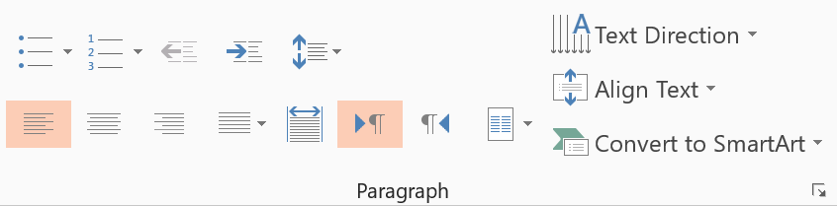
Notes to the template
Type levels and bullets
The standard text area has five predefined type levels.
You can move up or down the levels using the increase or decrease indent buttons in the home tab.
We recommend that you do not use the bullet button, as this does not apply the correct bullet formatting.
Level one is for general text
Level two is for subheadings within body copy
Level three is the first level of bullets
Level four is the second level of bullets
Level five is the third level of bullets
While text boxes are formatted to be the correct font, size, and colour, they will not contain the levels as a placeholder does. Therefore, it is recommended that you copy an existing text placeholder on the slide if you would like to insert a text box, to preserve the use of these levels.
Decrease list level
Increase list level

Slide 30

Notes to the template
Using picture slide layouts
The picture slides are predefined with picture placeholders that help you to manage the image you add into the field.
Click the button in the middle of the field to select and import the picture you want to use. The picture field will automatically fill the field with the image.
You can edit the position of the image using the crop tool, which is in the ‘Picture Tools > Format menu. This menu appears when you click on an image.
The crop tool allows you to enlarge, adjust position or crop the image to fit.

Slide 31

Notes to the template
Applying images to backgrounds
If you insert a Title or End Slide Image layout, you will find that the background is filled with a solid grey. This means that you can insert your own image to the background.
The first step is to right-click the background and choose Format Background – this will open a panel on the right of the screen.
Then, tick the Picture or texture fill box, and choose Insert Picture from File. Select an image from your computer, ensuring it follows brand guidelines, and the picture will automatically fill the background of the slide.

Slide 32
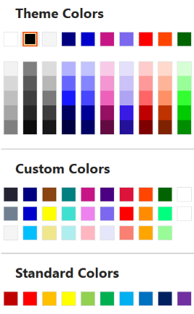
Notes to the template
Tips and recommendations
Type levels
Always use the type levels in the predefined content placeholders, supplied with each layout.
Text boxes
If you use text boxes, please note that they do not include the type levels. Any formatting has to be manually applied, and we recommend you adhere to the brand rules.
Footers
The footer and page number can be modified and turned on or off. To do this, go to the Insert tab on the ribbon, then click Header and Footer.
Colour palette
Always select a colour from the supplied colours.
The top row represents the correct brand colours and are automatically used in charts and diagrams.
The Custom Colors section contains all of the brand colours, some in multiple tints. Please use these as required.
The Standard Colors row is supplied by Office and does not follow brand guidelines. Please do not use these colours in your documents.

Slide 33
Thank you
Presentation Title
DD/MM/YYYY

